Slide 1
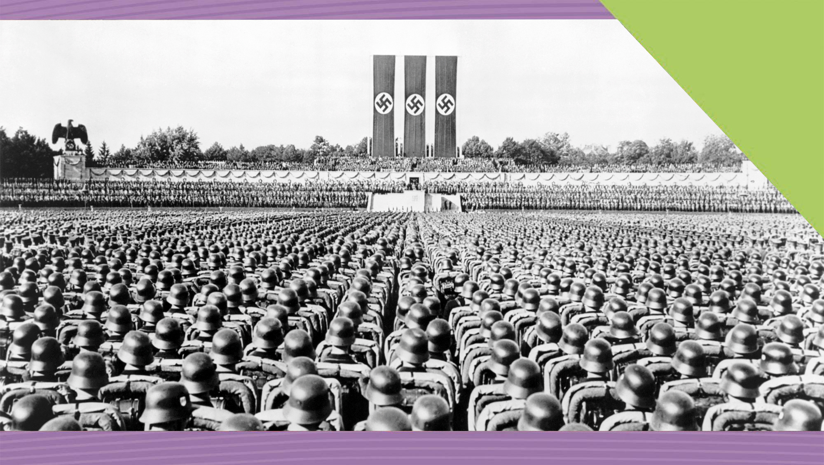
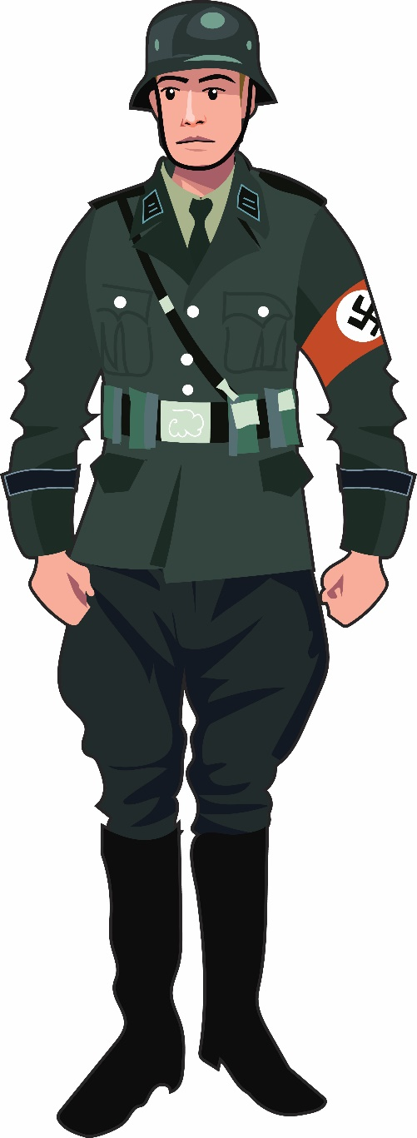

Life in Nazi Germany
17
A Fascist Country
Making History (2nd Edition)

Slide 2
What Will I Learn?
Examine life in Nazi Germany, a fascist country
Explore the Nature of History

Slide 3
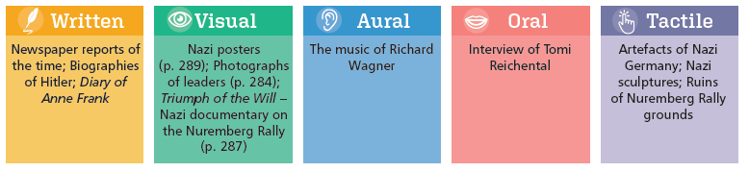
Sources for Nazi Germany

Slide 4
Key Words
Anti-Semitism | hatred of the Jews
Brownshirts | name given to Hitler’s Stormtroopers or SA
Concentration camps | camps set up by the Nazis in Germany or Communists in the Soviet Union (gulags) to imprison opponents
Dictatorship | a country being ruled or governed by a dictator
Enabling Act | law passed by Hitler that gave him power to rule by decree
Extermination camps | camps organised by the Nazis in Poland during World War II for killing Jews
Fascism | political belief of Mussolini in Italy and Hitler in Germany that was anti-democratic, anti-communist
Führer | (Leader) title of Hitler after he combined the offices of President and Chancellor
Ghetto | a separate area of a city occupied by people of one particular race or religion
Holocaust | the systematic slaughter of European Jews by Nazi Germany during World War II

Slide 5
Key Words
Lebensraum | Nazi policy of living space, to use Eastern Europe and Russia to provide raw materials and workers for the Nazis
Master Race | Nazi term for pure and superior white race who aimed to dominate or rule the world
Nuremberg Laws | Nazi laws against the Jews that deprived them of German citizenship, banned marriages with non-Jews and forced them to wear the Star of David
Pogrom | an organised massacre and persecution of an ethnic or religious group, usually applied to attacks on the Jews in Russia and Nazi Germany
Racism | belief that race decides a person's character and that some races are superior to others; prejudice against someone of a different race based on these ideas
Rule by Decree | where rulers such as Hitler can make laws without the need to pass them in parliament
Swastika | Nazi symbol of crooked cross

Slide 6
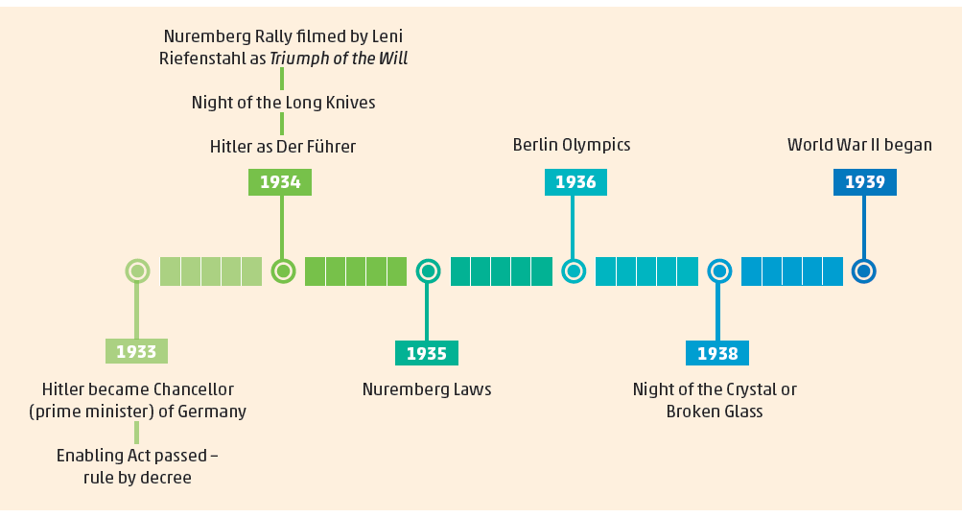
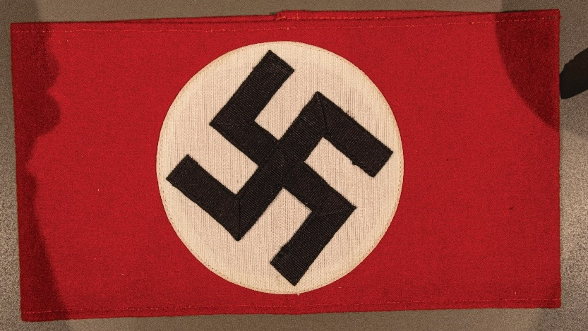
Timeline of Nazi Germany, 1933–39

Slide 7
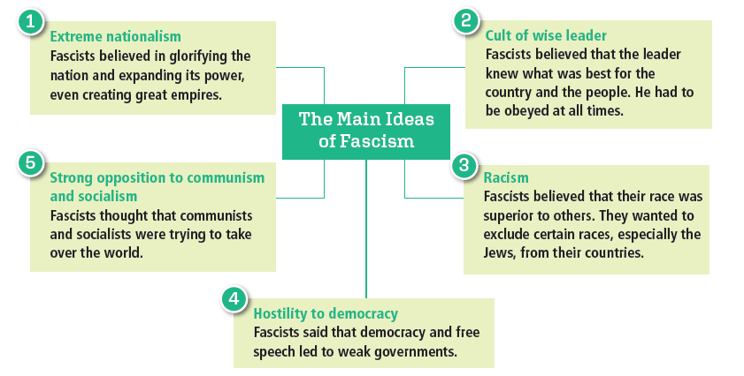
What was Fascism?

Slide 8
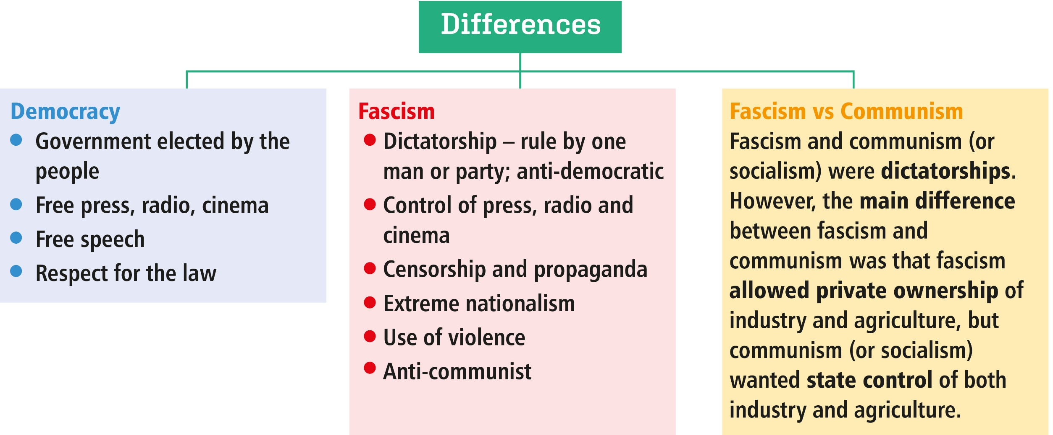
Democracy vs Dictatorships

Slide 9
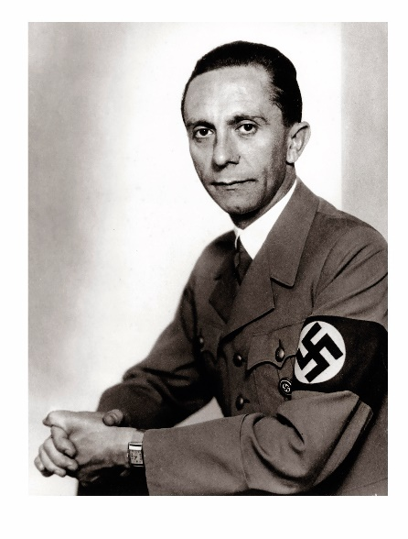
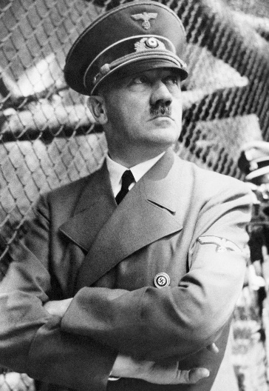
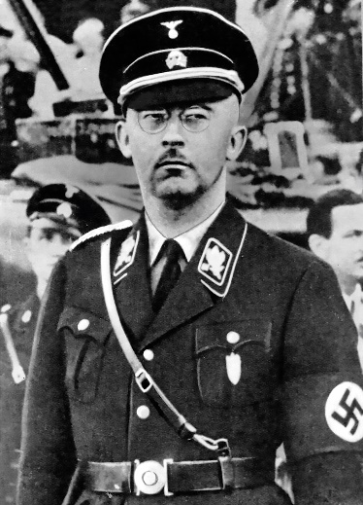
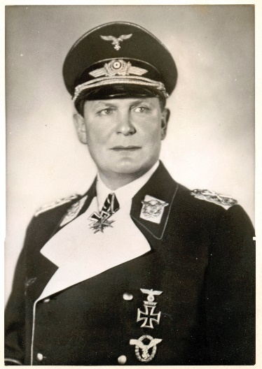
Who were the Nazis?
National Socialist German Workers Party (Nazi Party)
Joseph Goebbels, responsible for propaganda
Adolf Hitler, leader of the Nazi Party
Heinrich Himmler, head of the SS
Hermann Goering, Chief of the Luftwaffe (German Air Force)

Slide 10
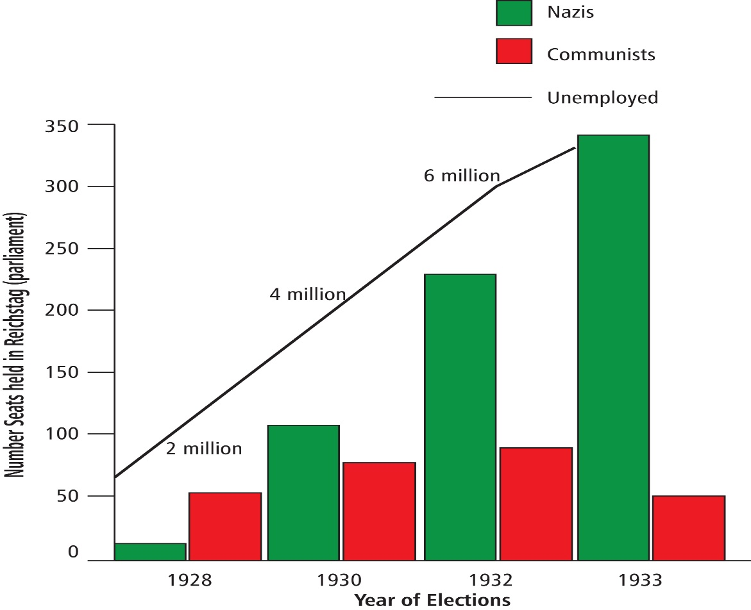

How did Hitler and the Nazis Gain Power in Germany?
How were the Nazis helped by the impact (effects) of the Great Depression?
Great Depression 1929

Slide 11
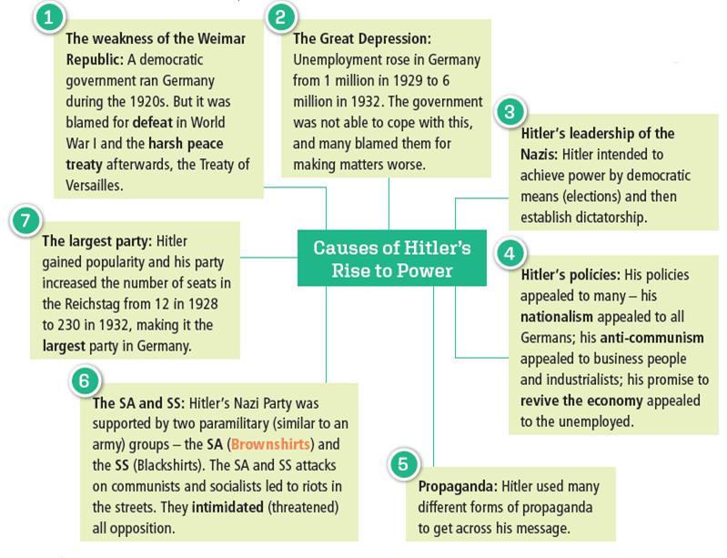

Slide 12

Assessing Your Learning
What is democracy?
What is dictatorship?
What is fascism?
Name two fascist dictators.
Name two differences between fascism and democracy.
What was the name of Hitler’s political party?
How did three of the following help Hitler’s rise to power?
(i) Weimar government (ii) Great Depression
(iii) Hitler’s policies (iv) Propaganda (v) SA and SS

Slide 13
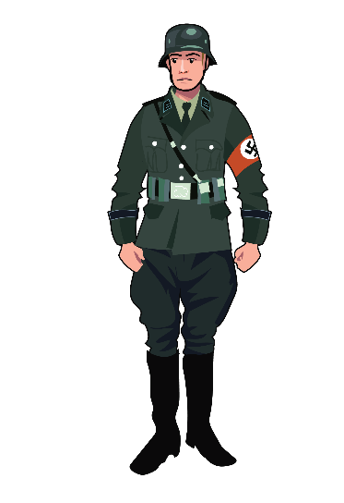
Nazi Germany – Life in a Fascist Dictatorship
Steps to dictatorship
General election, 1933
Reichstag Fire
Banned all political parties except the Nazi Party
Enabling Law – rule by decree
Police state
SS and Gestapo
Judges loyal to Hitler
Informers spy on families
Press, radio and cinema controlled
Hitler established a dictatorship
Death penalties in Germany for ‘political oppression’
1930–32 8
1933: Hitler comes to power
1934–39: 534

Slide 14
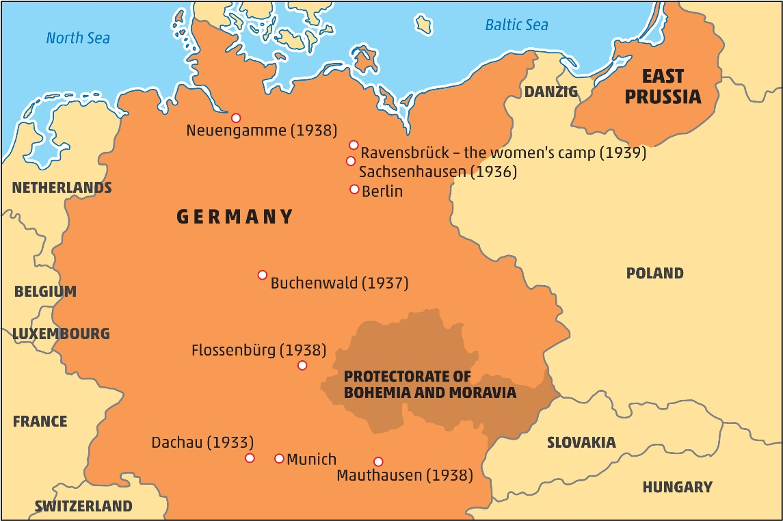
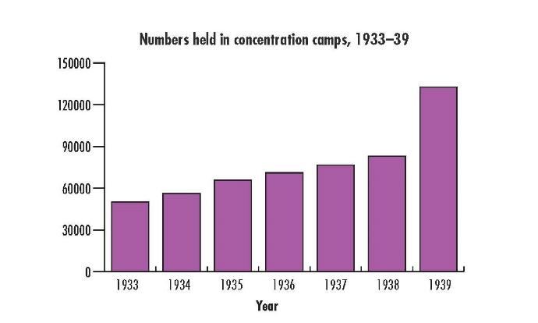
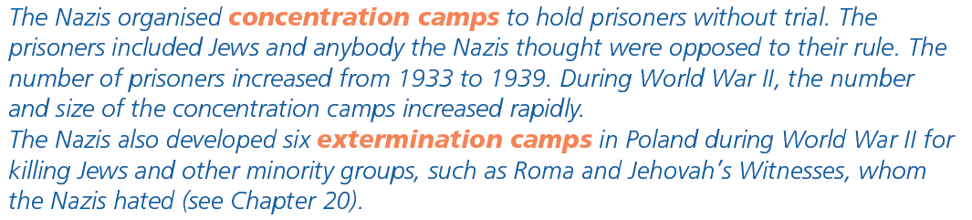
What Happened to the Opposition?
Opposition put into concentration camps, e.g. Dachau

Slide 15
What Happened on the Night of the Long Knives?
Leaders of SA, including Rohm, killed by SS
Hitler in total control of Nazis
Hitler became Der Führer (‘the Leader’) after death of President Hindenburg
Hitler can't walk over me as he might have done a year ago; I've seen to that. Don't forget that I have three million men, with every key position in the hands of my own people, Hitler knows that I have friends in the Reichswehr [German Army], you know! If Hitler is reasonable I shall settle the matter quietly; if he isn't I must be prepared to use force – not for my sake but for the sake of our revolution.
Ernst Röhm, leader of the SA, speaking in January, 1934

Slide 16
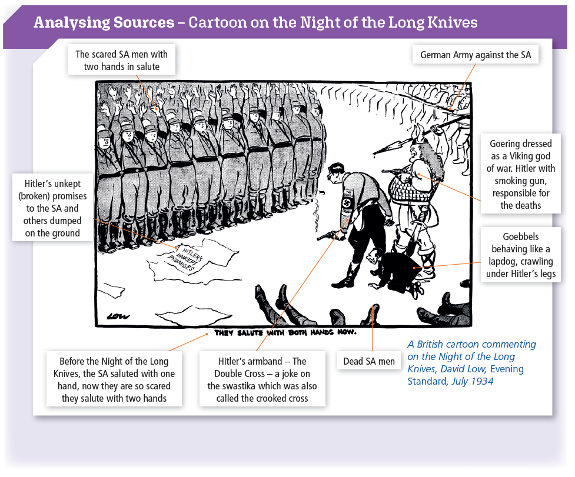
ANALYSING CARTOONS
Caption and labels
Symbols
Use of satire
Caricature/Exaggeration

Slide 17
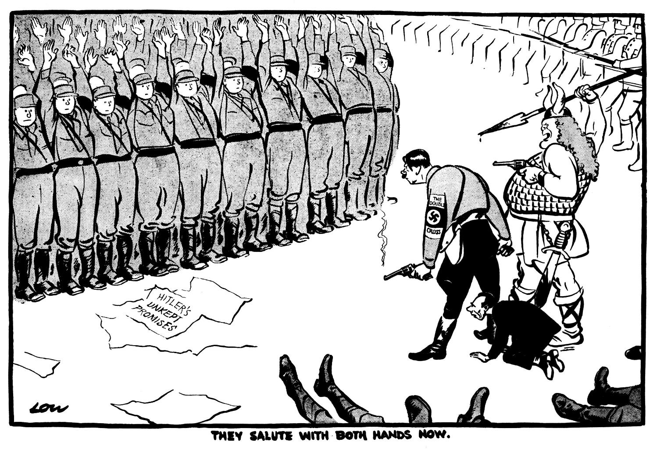
What Happened on the Night of the Long Knives?
Based on your study of this cartoon, what are the strengths and weaknesses of cartoons as sources for historians?

Slide 18
Assessing Your Learning
What was the Enabling Act?
Which of these are features of Hitler’s police state (i) SS and Gestapo (ii) oaths of loyalty (iii) concentration camps?
What was the difference between a concentration camp and an extermination camp?
On the Night of the Long Knives, which of the following occurred? (i) The SA were used to eliminate the leaders of the SS (ii) 85 were killed (iii) Hitler gave the orders
What was life like in Germany for those who opposed Hitler?

Slide 19
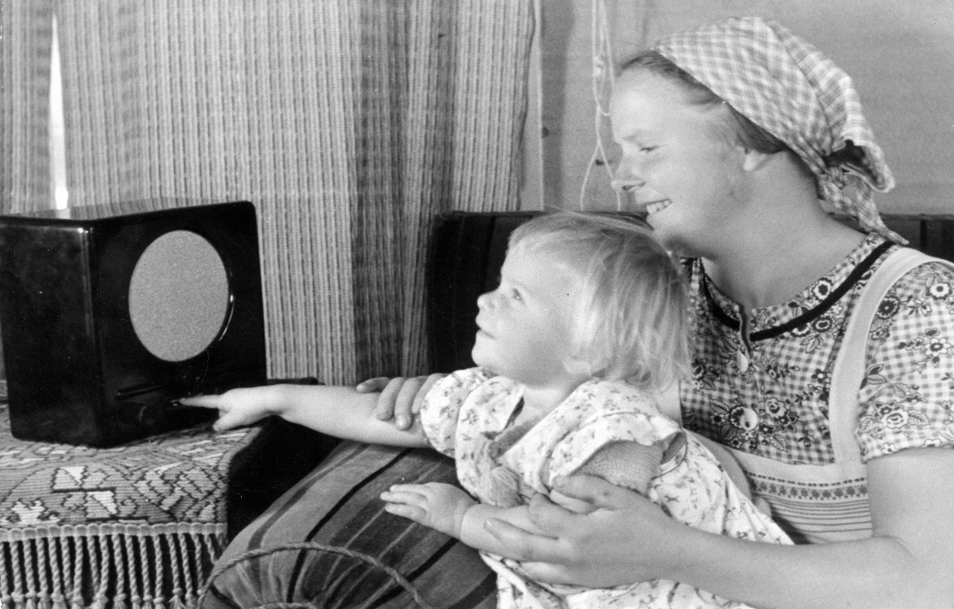
Living under Nazi Propaganda
Goebbels – Minister for Propaganda
Control of press, radio, cinema, theatre and art
Newspaper editors
Cheap radios – People’s Radio
Loudspeakers on streets
Olympic Games 1936 used for propaganda
Cult of personality/leader

Slide 20
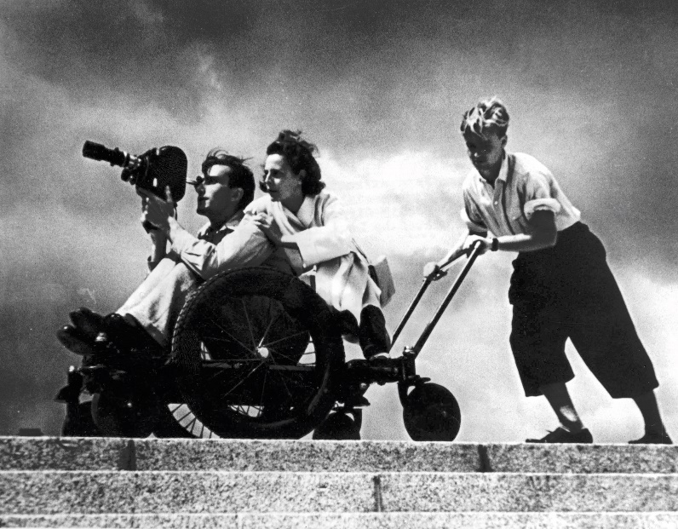
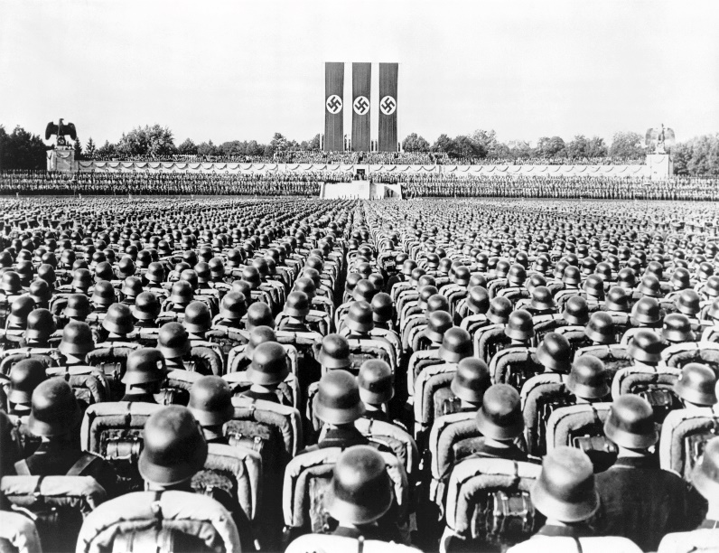
Living under Nazi Propaganda
Great rallies – Nuremberg Rallies
Torchlight parades
Olympic Games
Leni Riefenstahl
Nuremberg Rally

Slide 21
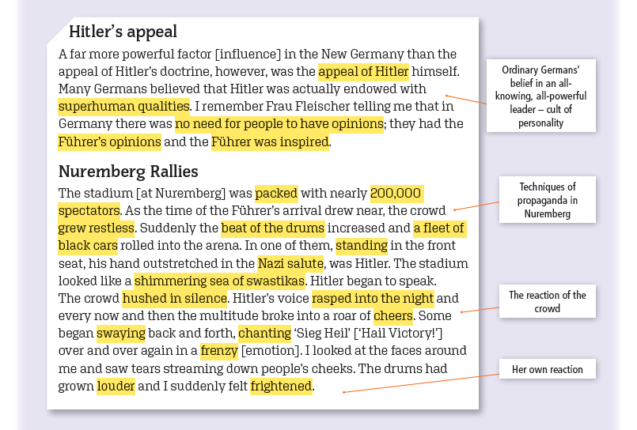
How do these extracts provide evidence of a cult of personality in Nazi Germany?
Virginia Cowles, Looking for Trouble (1941)

Slide 22
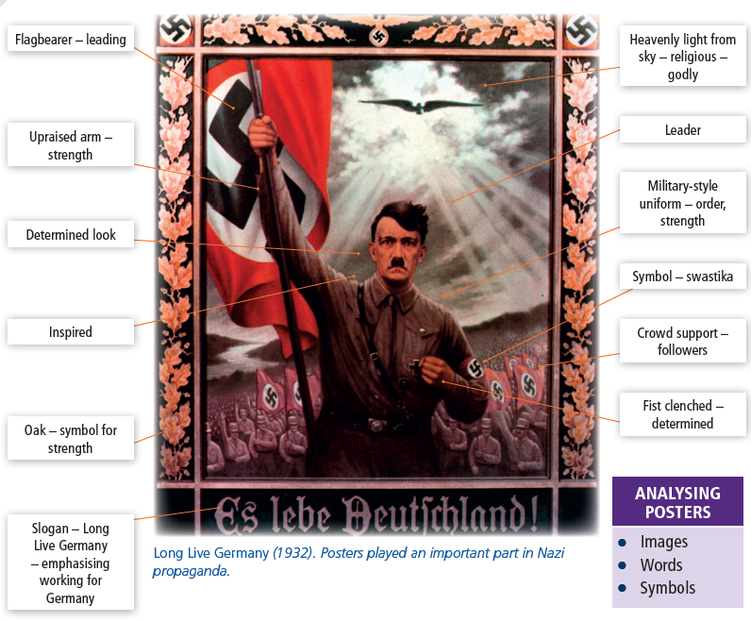

Slide 23
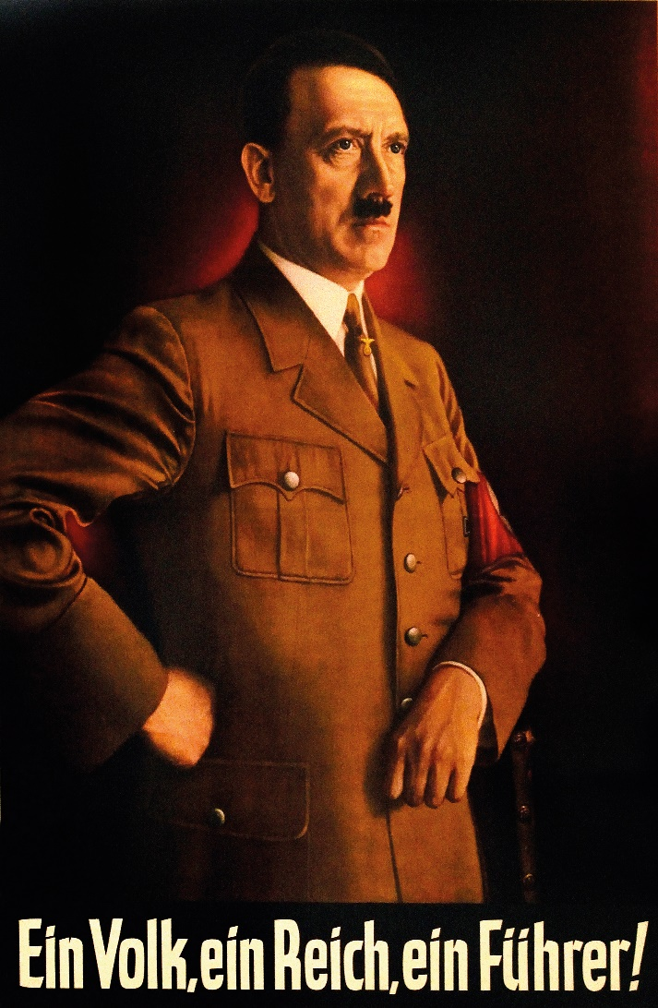
The Cult of the Leader
What are the strengths and weaknesses of posters as sources for historians?

Slide 24
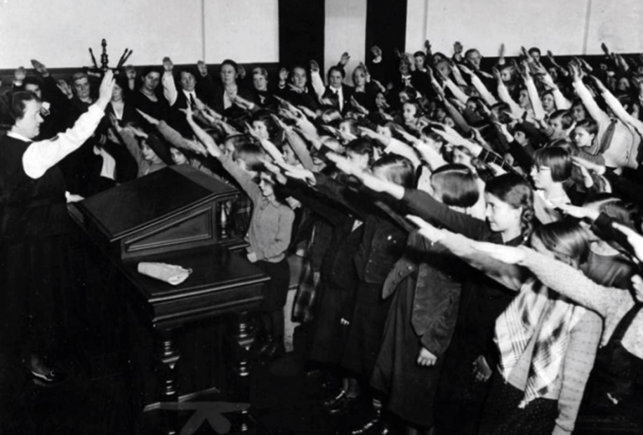
How did the Nazis Control the Young?
Education
Loyalty to the Führer
History books to glorify Germany’s past
PE to train youth
Boys for military service, girls for motherhood
Nazi ideas taught through maths
Nazi youth organisations
Edelweiss Pirates – youth opposed to Nazis
Young German Folk | Young Girls | Hitler Youth | League of German Maidens
Boys 10–14 | Girls 10–14 | Boys 14–18 | Girls 14–18

Slide 25
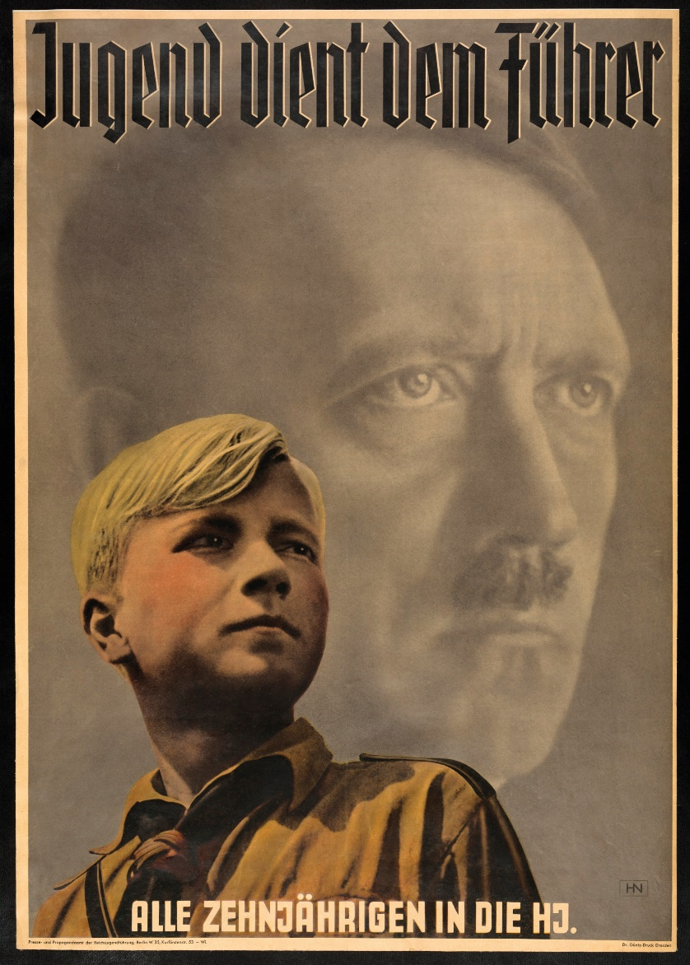
How did the Nazis Control the Young?
How does this poster promote the idea of loyalty and obedience to Hitler?
‘Youth serves the Fuhrer’
‘All 10-year olds in the Hitler Youth’
ANALYSING POSTERS
Images
Words
Symbols

Slide 26
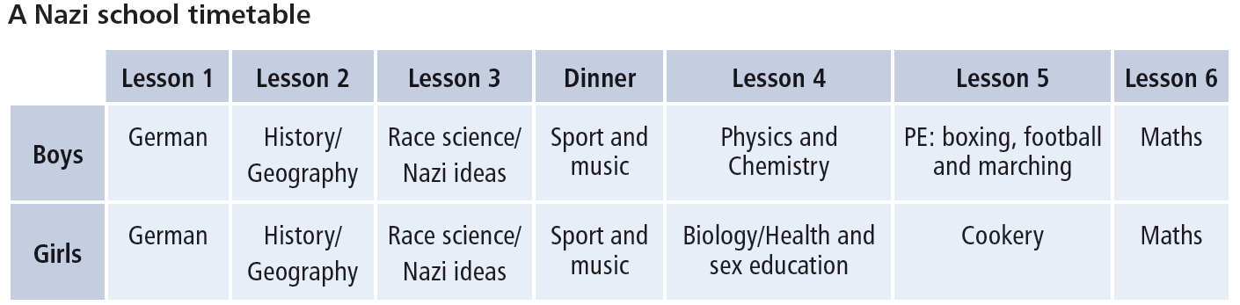
How did the Nazis Control the Young?

Slide 27
How did the Nazis Control the Young?
Nazi racial ideas in school
The Jews are aliens in Germany. In 1933 there were 66,060,000 inhabitants of the German Reich of whom 499,862 were Jews. What is the percentage of aliens in Germany?
(A question from a maths textbook)
My Leader!
(The child speaks:)
I know you well and love you
like a father and mother
I intend to obey you always
like father and mother
And when I grow up, I shall help you
like father and mother
And you should be proud of me
like father and mother
Anti-Semitism in a maths problem
Prayer for the Leader

Slide 28
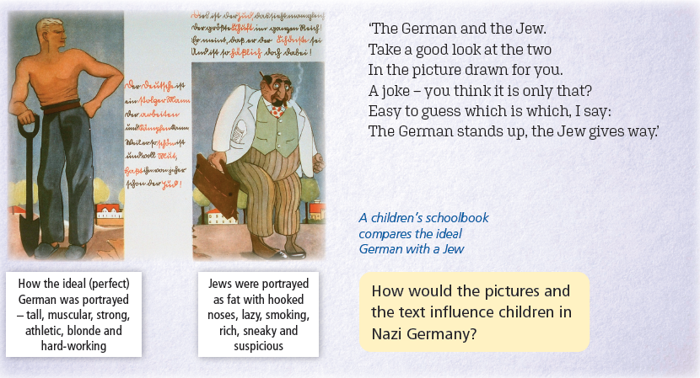
Nazi racial ideas in school
A children’s schoolbook compares the ideal German with a Jew

Slide 29
Assessing Your Learning
What role did propaganda play in the life of the people in Nazi Germany?

Slide 30
Assessing Your Learning
Fill in the missing words from the box below:
When Hitler was appointed … of Germany, he set about creating a … After a general election in 1933, he passed the … Law, which allowed him … by … He banned all … parties except the … Party. The …, secret police, were used to put down opposition. In this way, Hitler created a … state. On the Night of the … …, Hitler used the … to kill the leadership of the … He combined the positions of Chancellor and President in one office, and became … … He built … camps to hold prisoners without …
Long Knives Nazi SS Gestapo
trial SA Chancellor Der Führer
police dictatorship Enabling
rule political decree
concentration

Slide 31
Assessing Your Learning
Why was education important to the Nazis?
List two Nazi ideas that were to be taught in schools.
How was anti-Semitism taught in schools?
What Nazi youth organisations did (i) boys (ii) girls join?
What young people opposed Hitler?

Slide 32
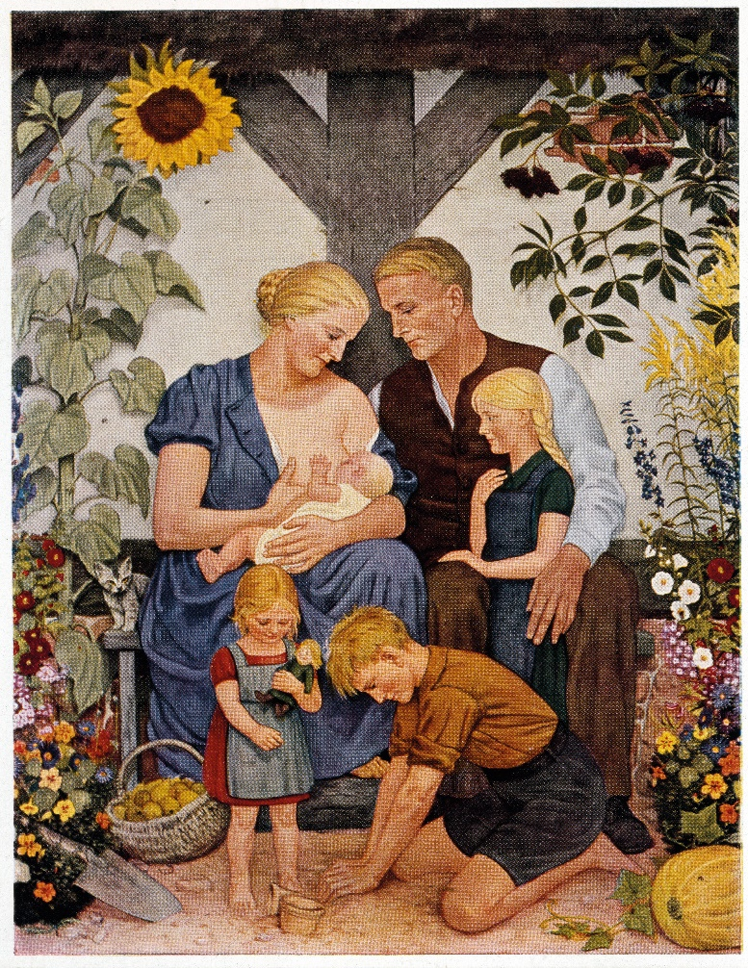
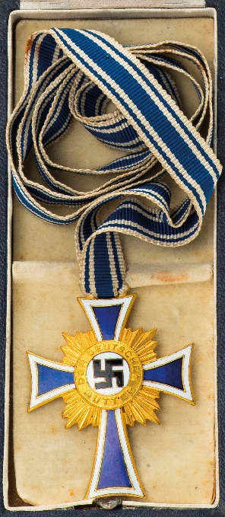
What was Life Like for Women in Nazi Germany?
Mothers with large families – Nazis’ ideal role for women
Kinder, Kuche, Kirche
Married women encouraged to give up jobs
Women teachers and civil servants sacked
Mothers’ Schools
Mother’s Day
Marriage loans to increase marriage rate and birth rate
Maternity benefits, family allowances, medals for mothers with large families
Nazis used sterilisation

Slide 33
Assessing Your Learning
What was the Nazi ideal for women?
What was Kinder, Kuche, Kirche?
How did the Nazis try to increase the birth rate?
Why did the Nazis want to increase the birth rate?

Slide 34
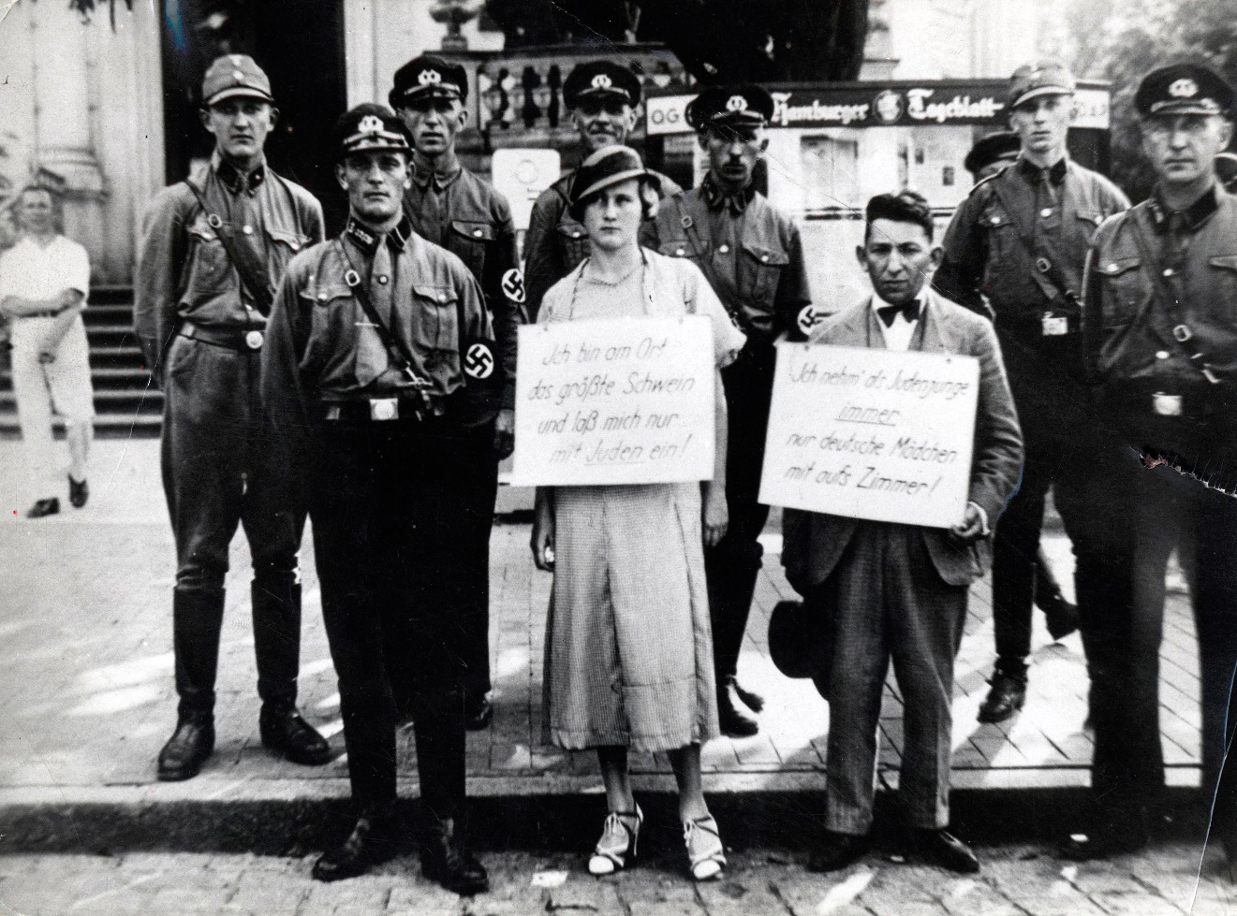
What was Life Like for the Jews in Nazi Germany?
Nazi racist ideas
Pure-blooded Aryan race
Master Race – superior race
Jews and others – inferior
Hitler’s anti-Semitism
Goebbels and propaganda
Jewish shops boycotted
Jews banned from civil service
Nuremberg Laws ‘for the promotion of German blood and honour’

Slide 35
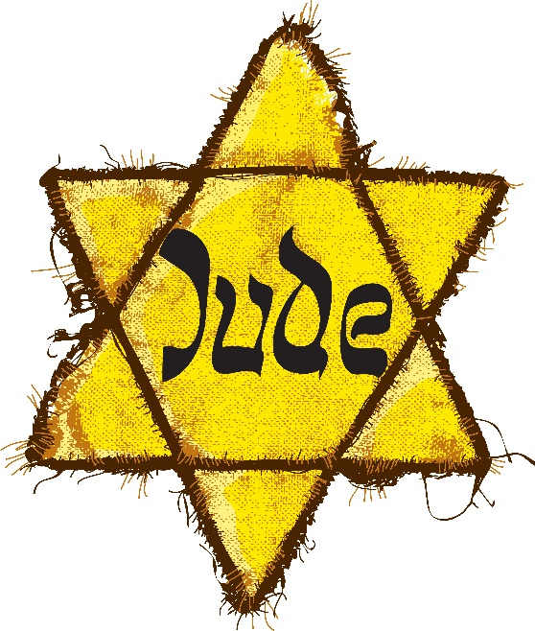
Nazis and the Jews
Some of the Laws Against the Jews
Nuremberg Laws
A citizen of the Reich [German empire] is a subject of German or kindred blood
Marriages between Jews and citizens of German or kindred blood are forbidden. …
Later laws against the Jews
Jews only allowed use specific Jewish first names
Jews forbidden to own shops or engage in trade
Jews over six years of age must wear the ‘Star of David’ in public
Influence of Jews
The Jew is the real cause of our loss of the Great War [World War I]. The Jew is responsible for our misery and he lives on it. He has corrupted our race, fouled our morals, undermined our customs and broken our power.
Joseph Goebbels (1930)
The Star of David

Slide 36
What Happened on the Night of the Broken Glass?
Kristallnacht, 1938
A night of violence against Jews
Attacks on Jewish shops and synagogues
Emigration of German Jews
Mob law rules
Mob law ruled in Berlin throughout the afternoon and evening as hordes of hooligans took part in an orgy of destruction. I have never seen an anti-Jewish outbreak as sickening as this. …
Daily Telegraph (London), 12 November, 1938

Slide 37
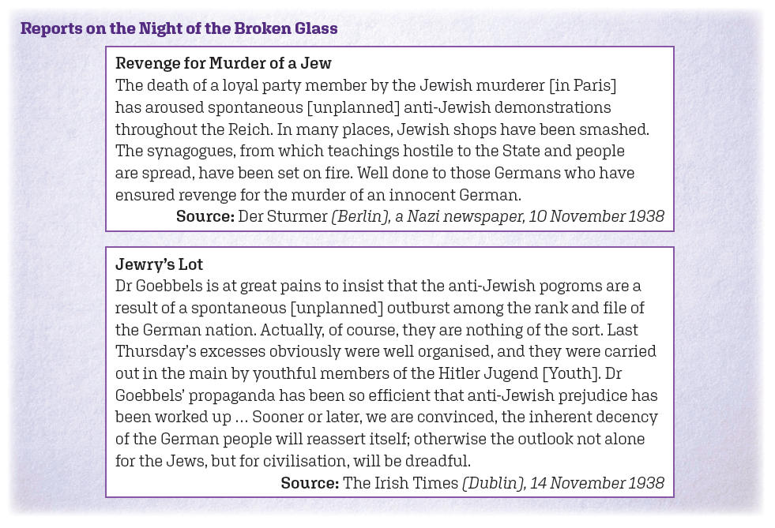
Compare these sources

Slide 38
Assessing Your Learning
True or false?
Hitler believed all people could be divided into superior and inferior races.
German people were racially pure, superior Alpha people.
Hitler’s hatred of the Jews was called anti-Semitism.
Hitler used maths problems to spread hatred against the Jews.
Jews could get jobs in the civil service provided they spoke German.
Goebbels said the Jews should not be blamed for Germany’s defeat in World War I.
Jews had to wear the Star of Saul.
The Night of the Broken Glass was known as Kristallnacht.
That night, Jewish shops and synagogues were not attacked if they put a swastika on the door.

Slide 39
Assessing Your Learning
Explain ‘Master Race’.
How did the Nazis view the Jewish people?
What were the Nuremberg Laws?
Under these and other laws, what happened to (i) Jewish shops (ii) Jews working in the civil service (iii) marriages between Jews and other Germans (iv) naming Jewish children?
On the Night of the Broken Glass, which of the following events occurred?
(i) Jewish shops were kept open (ii) Jewish synagogues were burned (iii) About 90 Jews were killed (iv) Hitler paid compensation to the Jewish businesses that were damaged

Slide 40

What was Life Like for Christians?
Catholics
Attacks on Catholic churches
Hitler saw Catholic Church as owing loyalty to another leader, the Pope
Pope Pius XI – With Burning Anxiety
Protestants
Hitler attacked Protestants
Set up a Protestant national church
Pastor Martin Niemoller opposed Hitler

Slide 41
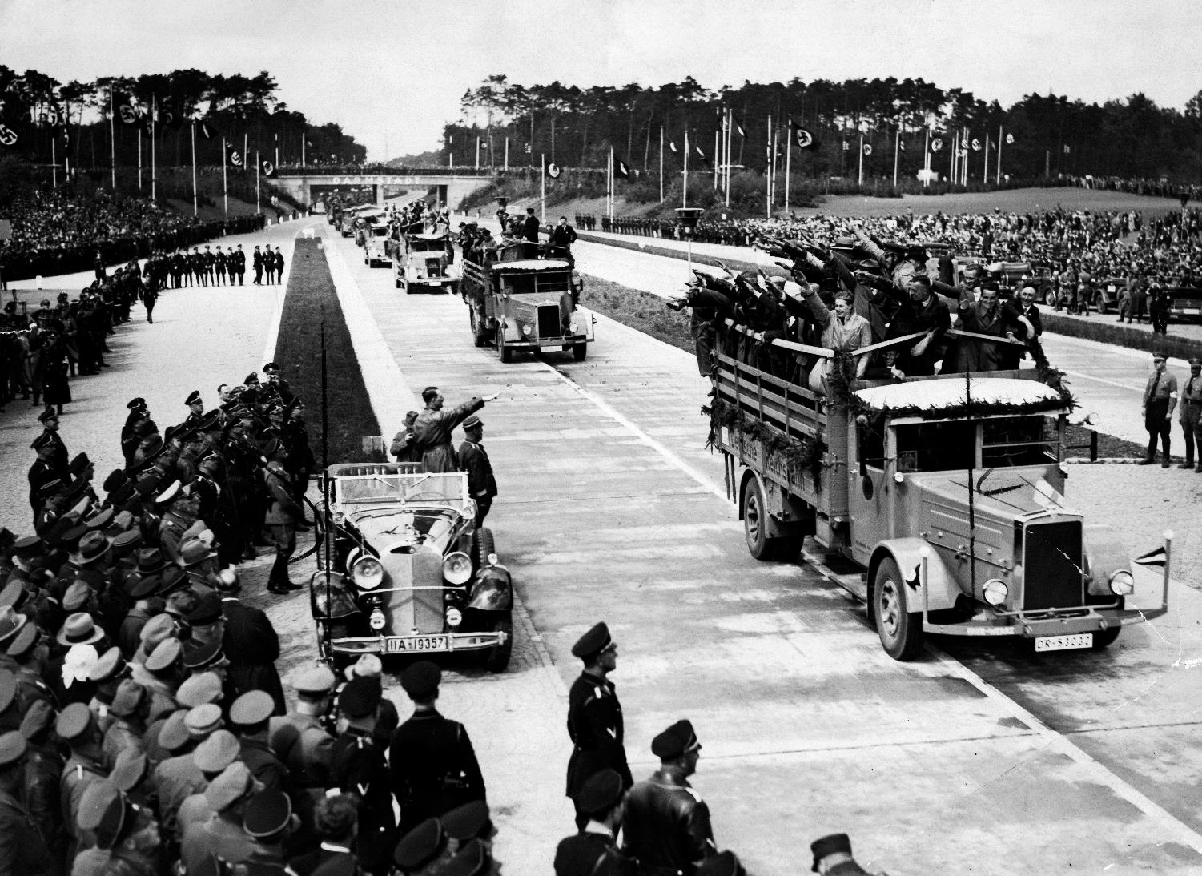
What was Life Like for Workers?
‘Work for all’
‘Battle for Work’
Unemployment reduced
Public works schemes
Motorways
Housing
Rearmament
Strength through Joy
Beauty of Labour
Motor industry
Lebensraum (living space in Eastern Europe) – raw materials
A new Autobahn - motorway

Slide 42
Were Workers Better or Worse Off Under Hitler?
Unemployment in Germany, 1928–39*
1928 | 1929 | 1930 | 1931 | 1932 | 1933
8.4% | 13.1% | 15.3% | 23.3% | 30.1% | 26.3%
1934 | 1935 | 1936 | 1937 | 1938 | 1939
14.9% | 11.6% | 8.3% | 4.6% | 2.1% | 0.6%
*Jews, prisoners, part-time workers not included in unemployed
Did workers get more jobs?

Slide 43
Were Workers Better or Worse Off Under Hitler?
Average weekly wages
1932 | 86 marks
1938 | 109 marks
Average hours of work in industry (per week)
1933 | 42.9
1939 | 47
Were workers better paid?

Slide 44
Life in Nazi Germany during World War II
Country geared up for ‘total war’
Industry and agriculture producing for the war
Use of forced labour from conquered countries
Food shortages
Rationing
Bombing of German cities by Allies
Huge expansion of concentration camps and extermination camps
The Final Solution against the Jews
German Daily Ration of Food
Jam | 0.25 oz (7 g)
Butter, fat | 1.25 oz (35 g)
Sugar | 1.25 oz (35 g)
Meat | 2.5 oz (if it could be got) (64 g)
Coffee | 0.25 oz (7 g)

Slide 45
Assessing Your Learning
Match the Key Words with the correct explanation:
1. Enabling Act | More control of the Jews
2. Führer | Power to rule without asking parliament
3. Night of the Long Knives | Pure-blooded Aryan race
4. Night of the Broken Glass | Hatred of the Jews
5. Rule by decree | Attack on Jewish businesses and synagogues
6. Nuremberg Laws | Belief that race decides a person’s character
7. Master Race | Leader
8. Anti-Semitism | Gave all power to Hitler
9. Racism | Murders of SA leaders by SS

Slide 46
Assessing Your Learning
Why did Hitler fear the Catholics?
What was With Burning Anxiety?
How did Hitler treat Protestants?
What was the ‘Battle for Work’?
How did Hitler provide work with (i) public works schemes (ii) rearmament?
Explain Strength Through Joy and Beauty of Labour.
How successful was Hitler in solving Germany’s unemployment problem?
What was lebensraum?

Slide 47
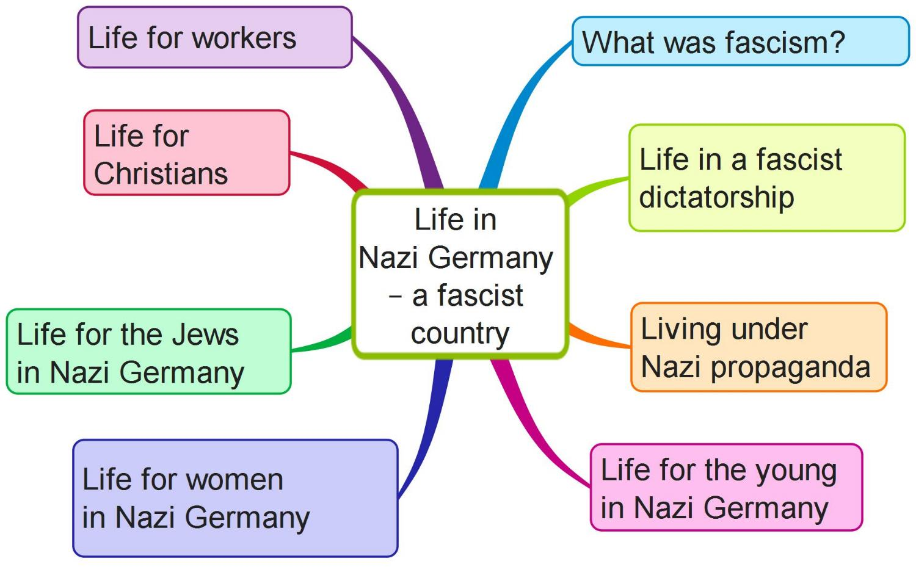
Create your own mind map on Life in Nazi Germany using the above features

Slide 48
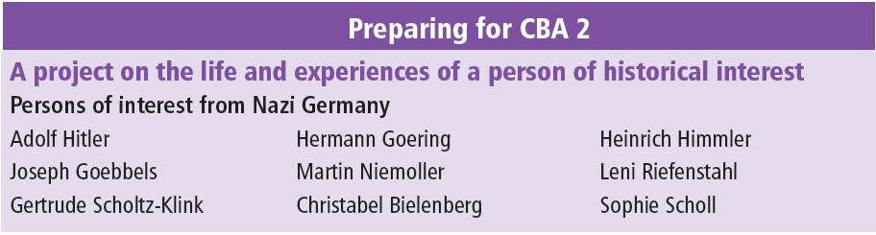
Preparing for CBA 2
**Note your choices**

